Slide 1
Network Cabling
UBMS Stem Experience: Jurassic Park

Slide 2
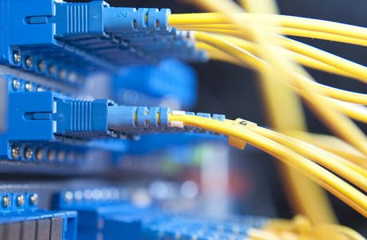
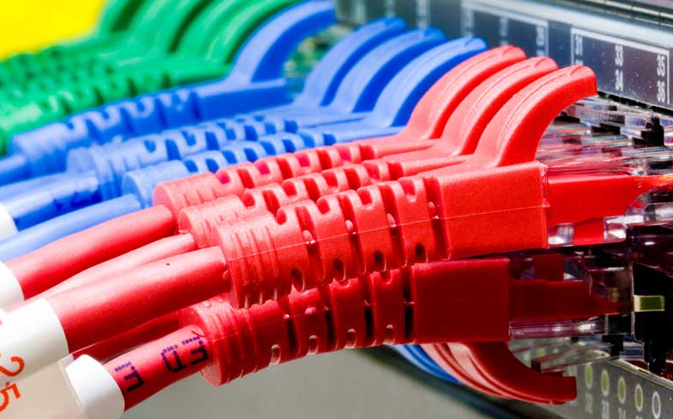
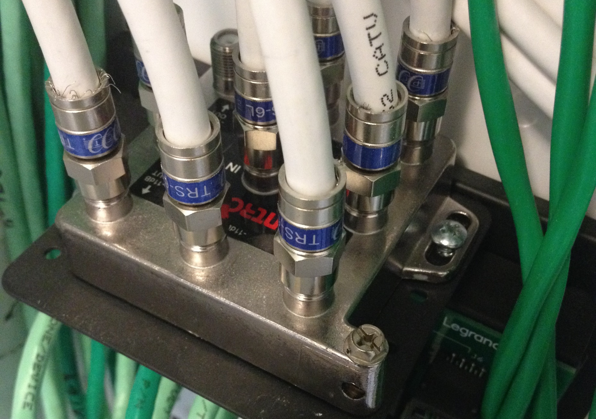
Network Cabling
Notes:
Cable is the medium through which data usually moves from one network device to another. Be aware that I am not saying that it is the only way, since we also have wireless technology, but some cabling is also involved in connecting those devises as well.
There are several types of cable which are commonly used with LANs. In some cases, a network will utilize only one type of cable, other networks will use a variety of cable types. The type of cable chosen for a network is related to the network's topology, protocol, and size.
Understanding the characteristics of different types of cable and how they relate to other aspects of a network is necessary for the development of a successful network. In addition to learning about their characteristics, it is also important to learn about how to terminate these following industry standards. It is great if you can just order them but at times, you cannot control the end result of your structured cabling, it could be that you are looking for a professional look as well, and often times, it only happens when you make your own custom termination.

Slide 3
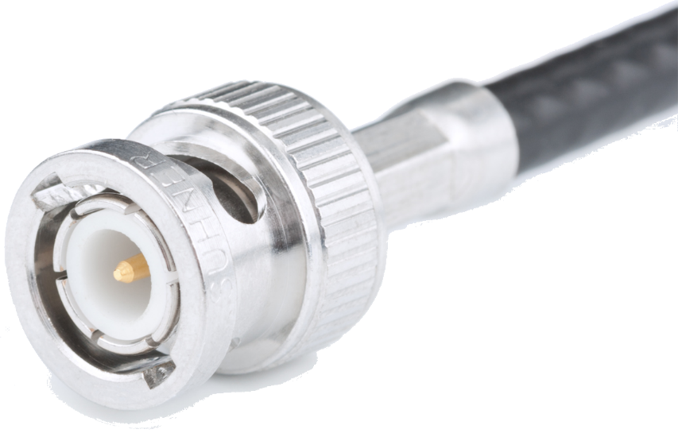
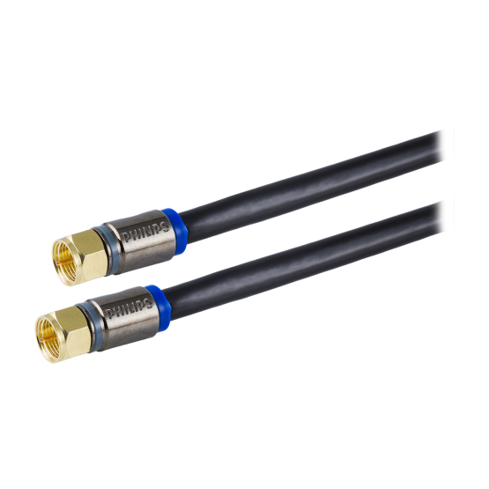
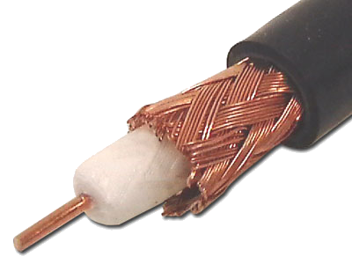
Cabling-Coaxial
Made up of 4 layers
Thinnet (RG-58)
Outer Insulator
Shielding Wire Mesh
Inner Insulator
Copper Core
Thicknet RG-59 and RG-6
Notes:
One of the first types of cable used in a network was coaxial cable. Coaxial cable is highly resistant to signal interference. In addition, it can support greater cable lengths between network devices than twisted pair cable. You have now gotten used to seeing coaxial cable when working with television systems, but prior to current technologies, it was the norm when connecting a network.
A type of coaxial cable was
Thinnet or RG-58
Was also know as 10Base2 which refers to the specifications for thin coaxial cable carrying Ethernet signals. During the mid to late 1980s this was the dominant 10Mbit/s Ethernet standard but due to the immense demand for high speed networking, the low cost of category 5 Ethernet cable, and the popularity of wireless networks, both 10BASE2 and 10BASE5 have become increasingly obsolete.
The name 10BASE2 is derived from several characteristics of the physical medium. The 10 comes from the transmission speed of 10 Mbit/s (millions of bits per second). The BASE stands for baseband signaling, and the 2 for a maximum segment length approaching 200 m (the actual maximum length is 185 m). When used for networking, it used a connector called a BNC connector as can be appreciated in the graphic.
We also had Thicknet.
Also know as 10Base5 referring to the specifications for thick coaxial cable carrying Ethernet signals. Using this cable, it was possible to connect up to 100 stations using what is called vampire taps and also share a single collision domain.
Following naming conventions of 10Base2, the 5 refers to the maximum segment length being 500 meters.
Thick coaxial cable has an extra protective plastic cover that helps keep moisture away from the center conductor.
One disadvantage of thick coaxial is that it does not bend easily and is difficult to install.
Typical coaxial cable is made up of 4 layers:
Copper Core
Inner Insulator
Shielding Wire Mesh
Outer Insulator
The RG-59 and RG-6 type of coaxial cable is typically used for cable TV

Slide 4
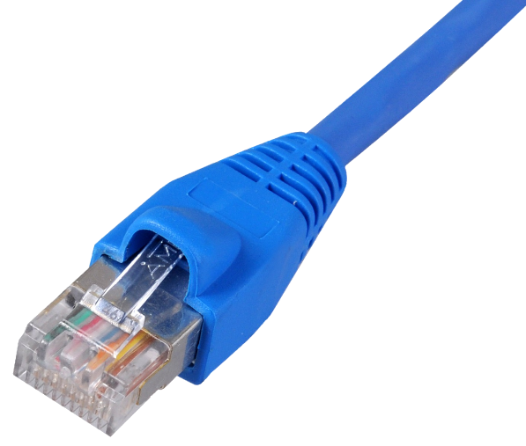
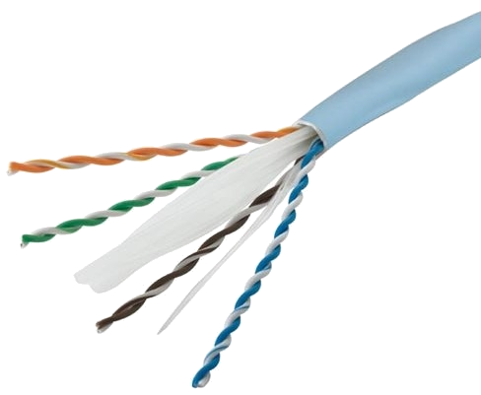
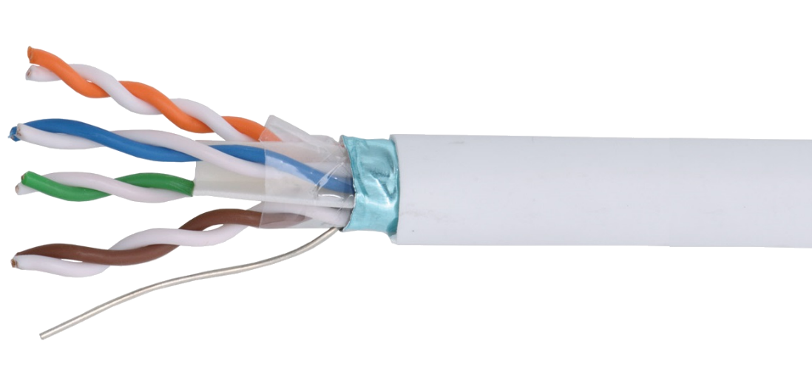
Cabling-Twisted Pair
Typically uses RJ-45 connector for networking
Unshielded Twisted Pair (UTP)
Shielded Twisted Pair (STP)
Notes:
A more common and prevalent type of cable is Twisted pair cabling. Twisted pair cabling is a type of wiring in which two conductors of a single circuit are twisted together for the purposes of canceling out electromagnetic interference (EMI) from external sources; for instance, electromagnetic radiation from unshielded twisted pair (UTP) cables, and crosstalk between neighboring pairs. It was invented by Alexander Graham Bell. It is also important to note that another characteristic of this type of cable is that they are twisted a number of times around each other over a meter, which is know as the twist rate.
This cable come in different categories and each one has improvements over the other. For example we have
CAT 3 with transmission speeds of 10 Mbps, we have CAT 5 with speeds of up to 100 Mbps, CAT 5e with 1000 Mbps and CAT 6 1000 Mbps
A type of cable configuration common to this type of cable is UTP or Unshielded Twisted Pair. Modern Ethernet, the most common data networking standard, can use UTP cables. Twisted pair cabling is often used in data networks for short and medium length connections because of its relatively lower costs compared to optical fiber and coaxial cable.
Another cable configuration is the shielded Twisted Pair or STP. All categories can travel up to 100 meters before suffering from attenuation. So, what is attenuation? Well, it is the degradation of the quality of a signal over an increasing distance in cable length.
A common aspect of both types of cables is that they both use what is called an RJ-45 connector as a means of providing connectivity to network devices.

Slide 5
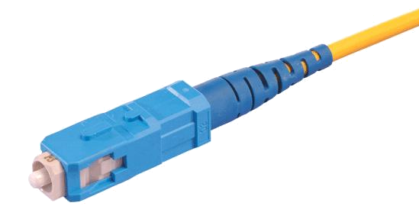
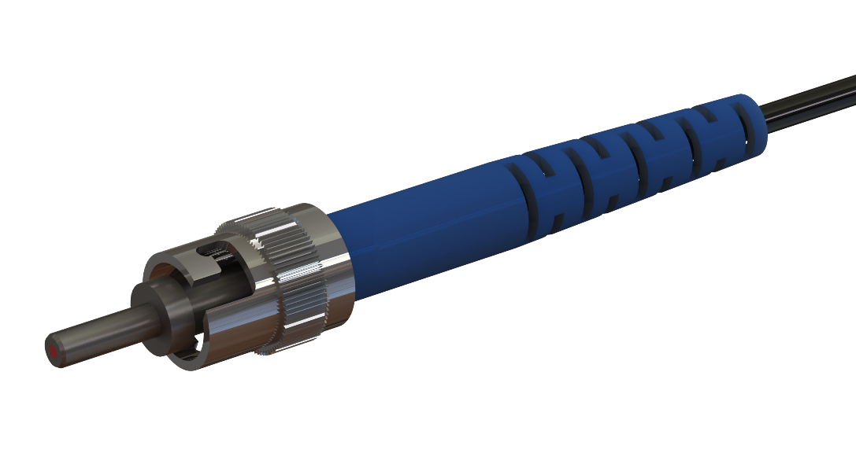
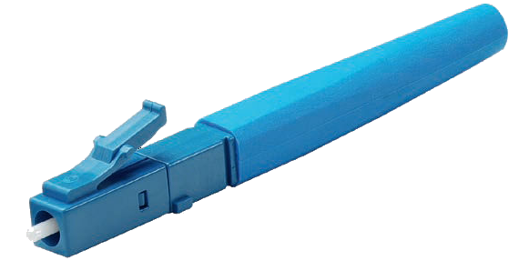
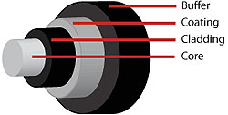
Cabling- Fiber
Suffers less from signal interference
Longer transmission distances
More fragile than copper
Two types:
Single mode
Multimode
SC Connector
ST Connector
LC Connector
Notes:
A different type of cable available for data transmission is fiber. Fiber optic cable uses light pulses instead of electricity to transmit data. The use of fiber cable has significant advantages over copper (that is, UTP or STP) as follows:
Benefits
More secure-since it uses light to transmit data, then it is almost impossible to tap into and eavesdrop in the communication process. In addition, and for the same token, it is not susceptible to electromagnetic interference. Transmission speeds can be very fast and research has shown that they have been able to achieve speeds of over 100 petabit per kilometer per second. The use of fiber overcomes the limitations imposed by copper where there is degradation of signal after 100 meters or about 300 feet in length.
Long Distances
Drawbacks
The advantages are great when comparing it over copper but on the other hand, it is more expensive and difficult to splice and it has also been demonstrated that at higher power, fiber is more susceptible to fuse, which can result in catastrophic destruction of the fiber core and thus damage to transmission components. In contrast to copper, fiber is not very flexible and if care is not taken, it can break easily once the minimum radius curvature is not observed.
Connectors
When terminating fiber, different connectors are available such as SC, ST, and LC type connectors. These can be appreciated in the graphic shown at the moment.
Fiber optic cables can come in either of two types single mode or multimode. Single Mode fiber optic cable has a smaller core that allows only one mode of light to propagate. Because of this, the number of light reflections created as the light passes through the core decreases, lowering attenuation and creating the ability for the signal to travel longer distances. Most single mode relies on a laser based light source for data transmission. Multimode fiber optic cable has a larger core that allows multiple modes of light to propagate. Because of this, the number of light reflections created as the light passes through the core increases, creating the ability for more data to pass through at a given time. Because of the high dispersion and attenuation rate with this type of fiber, the quality of the signal is reduced over long distances. This application is typically used for short distance and most often uses LED light source for transmission.

Slide 6
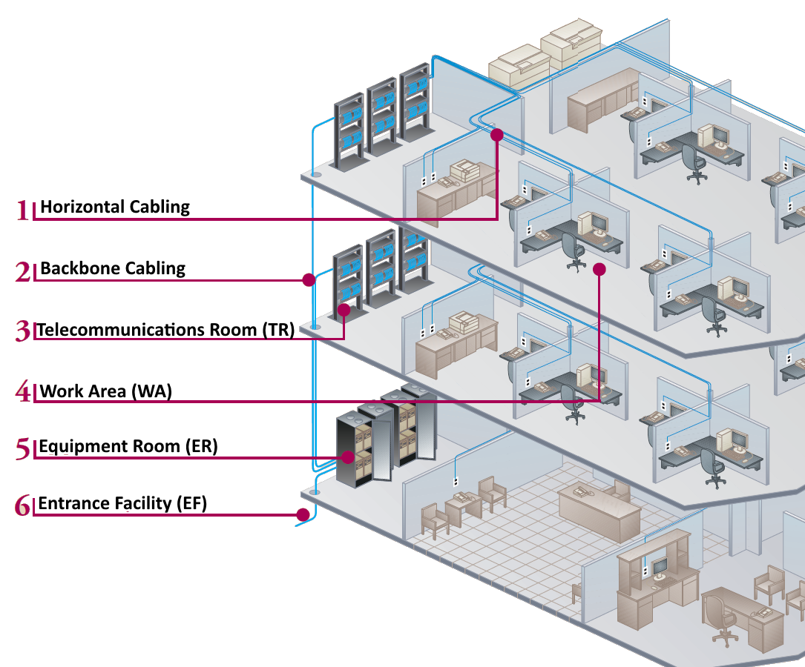
Overview

Slide 7
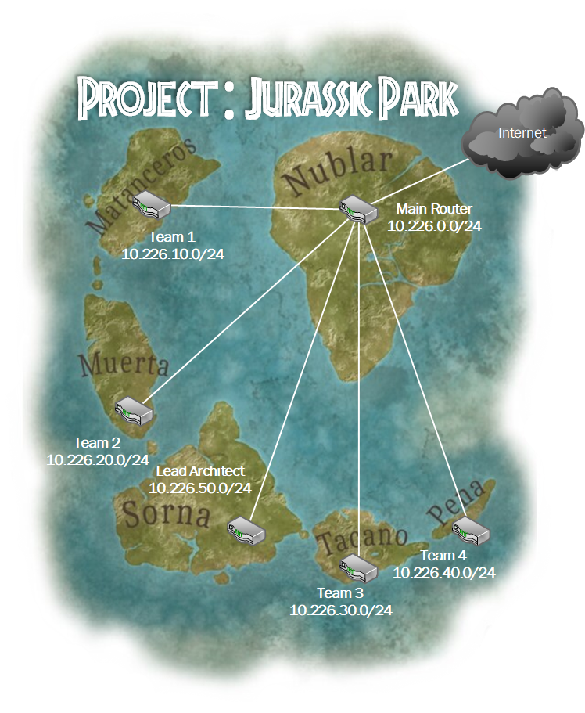
Project :
Jurassic Park
There will be 4 teams of 3 people
Each team will be assigned to one of the Jurassic Park islands
Teams will setup the networks for their island
All islands will be connected to the main park island

Slide 8
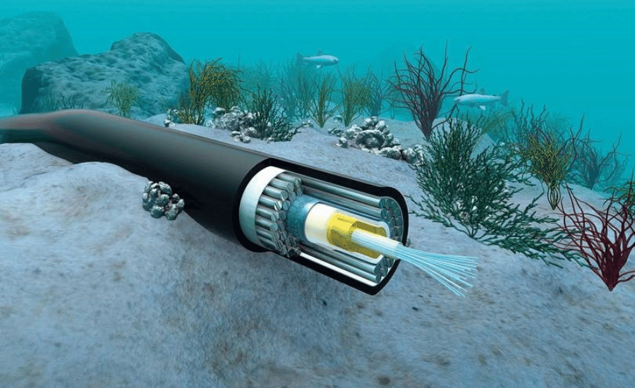

Slide 9
Cabling Lab

Slide 10
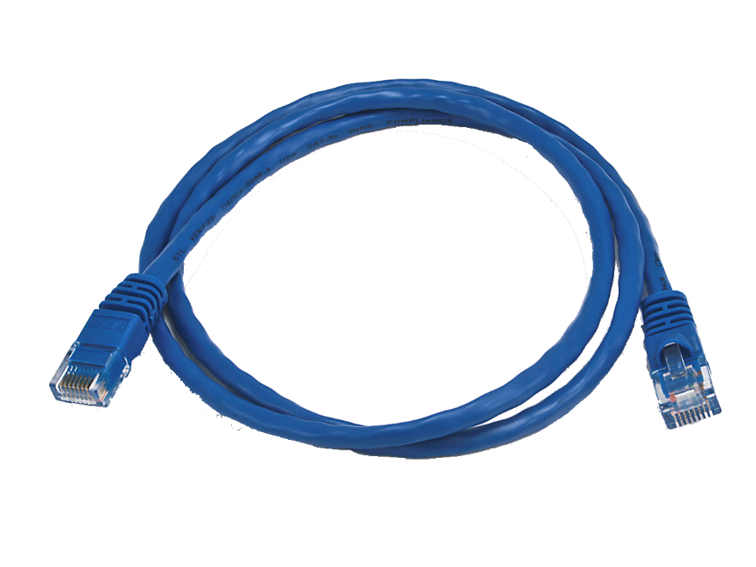
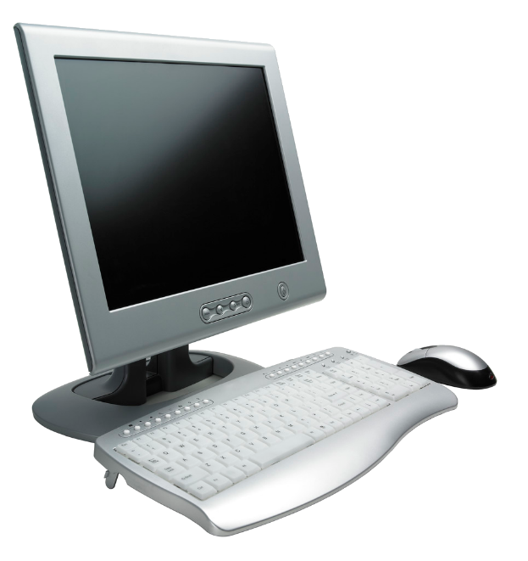
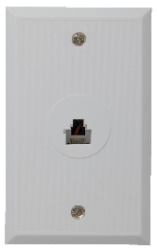
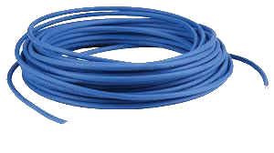
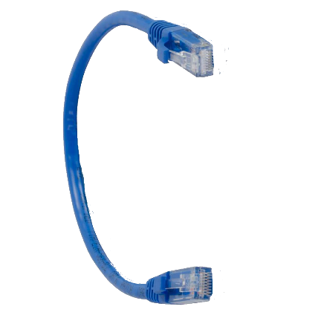
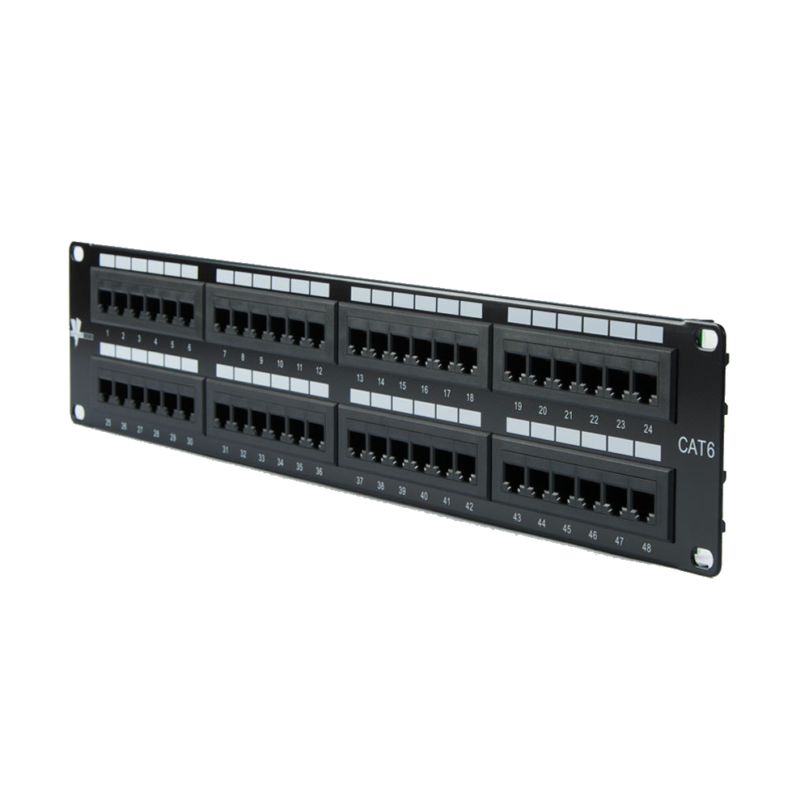
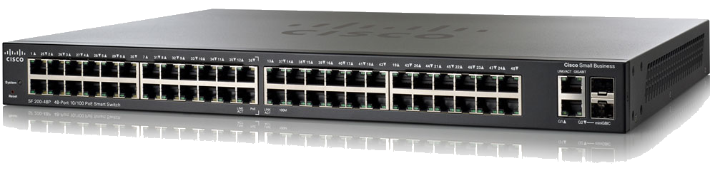
Structured Cabling
Single Jack RJ45 Wall Plate
Patch cable
PATCH PANEL
Patch panel to wall plate. 90m max.
Patch cable
SWITCH

Slide 11
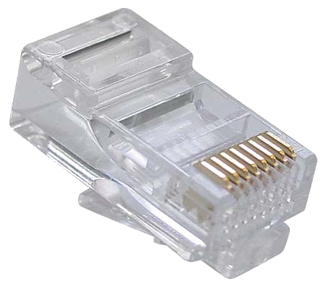
RJ-45 Connector
An RJ45 has eight pins but we only use 4 of those pins. Pins 1 and 2 (orange) are used for transmission and pins 3 and 6 (green) are used for receiving.
Crimp area
Copper Pins
Pin 8
Clip
Pin 1

Slide 12
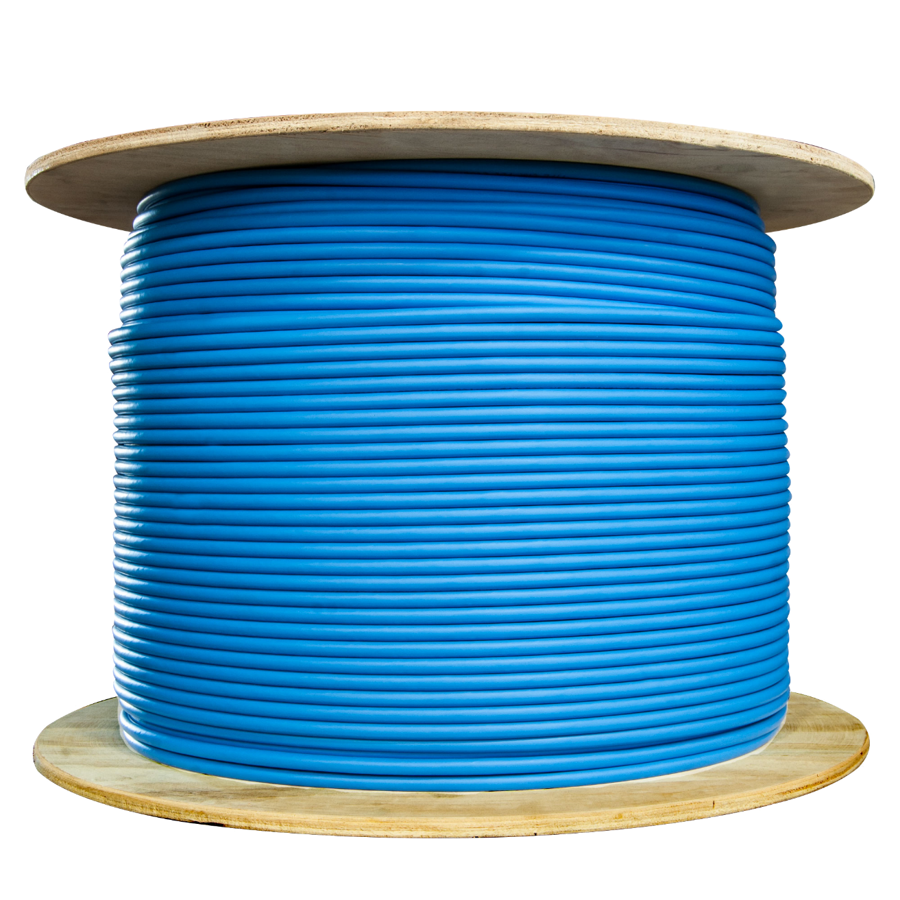
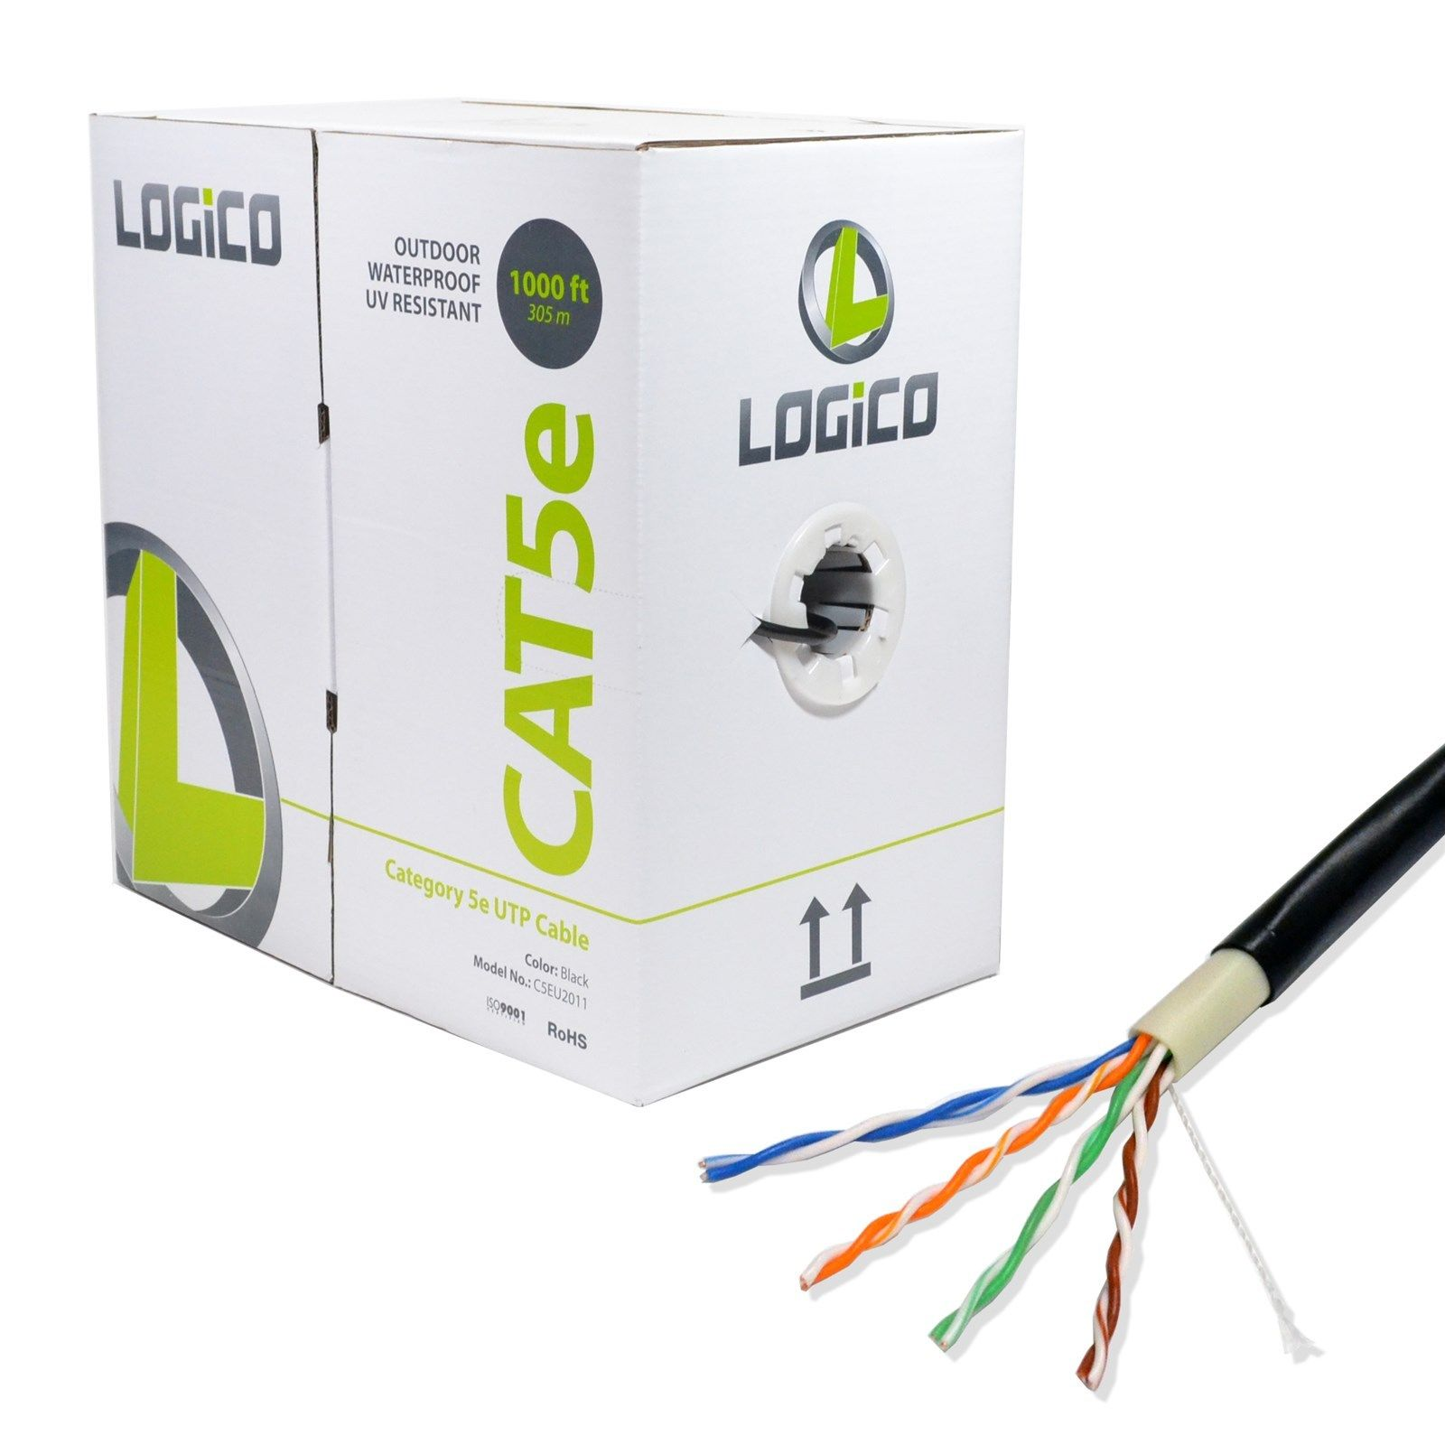
Bulk Cable

Slide 13
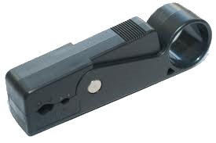
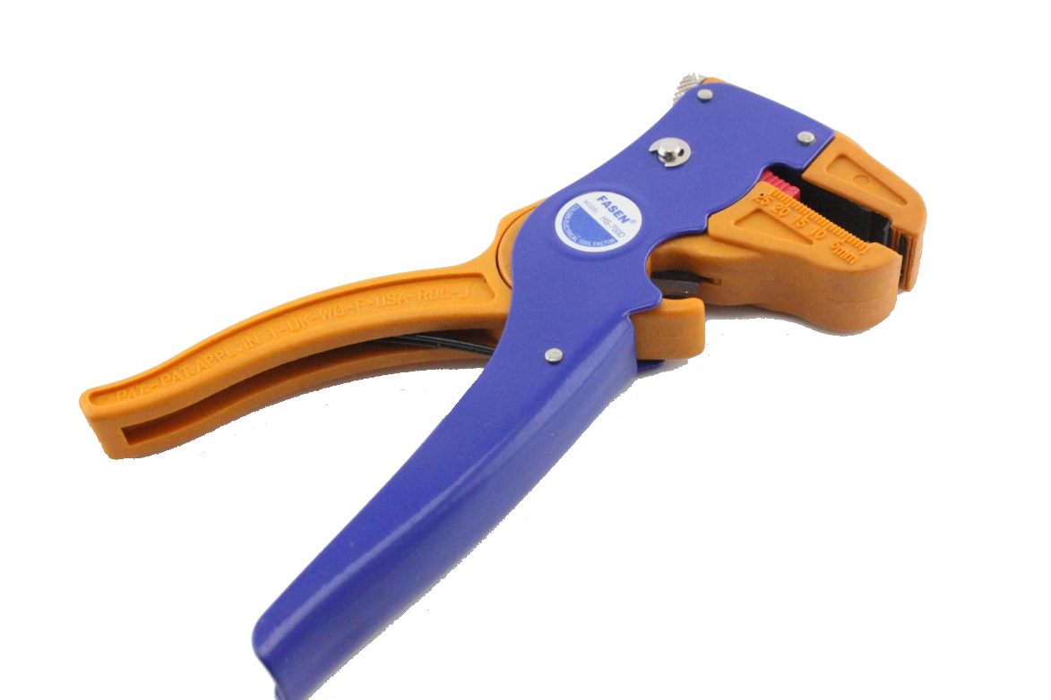
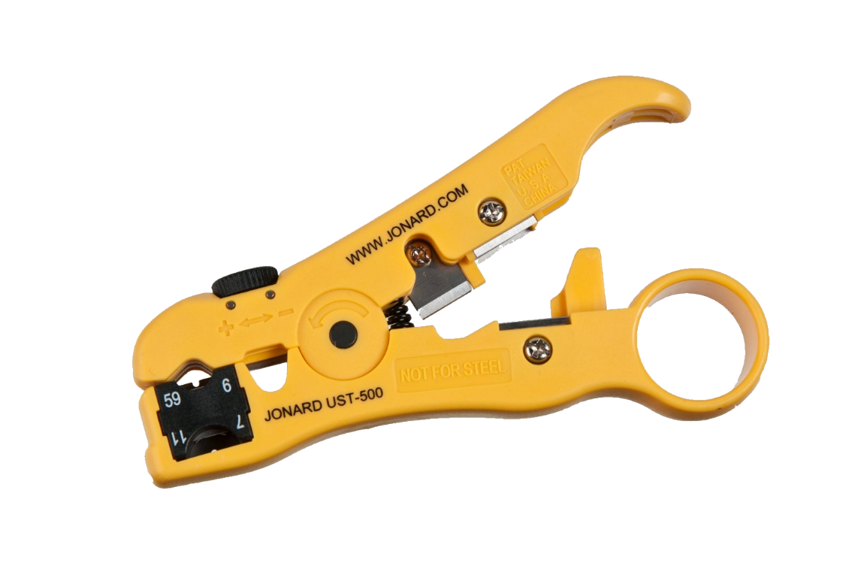
Tools-Cable Stripper

Slide 14
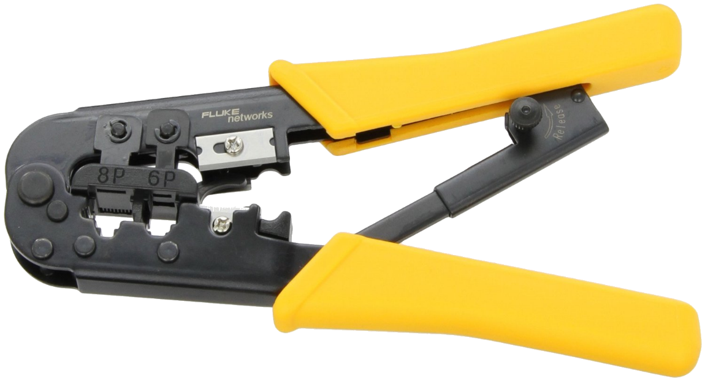
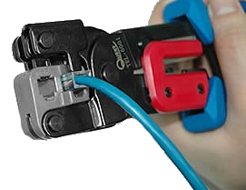
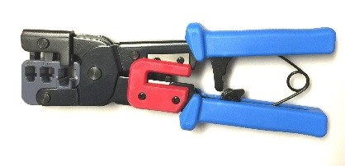
Tools-Crimper

Slide 15
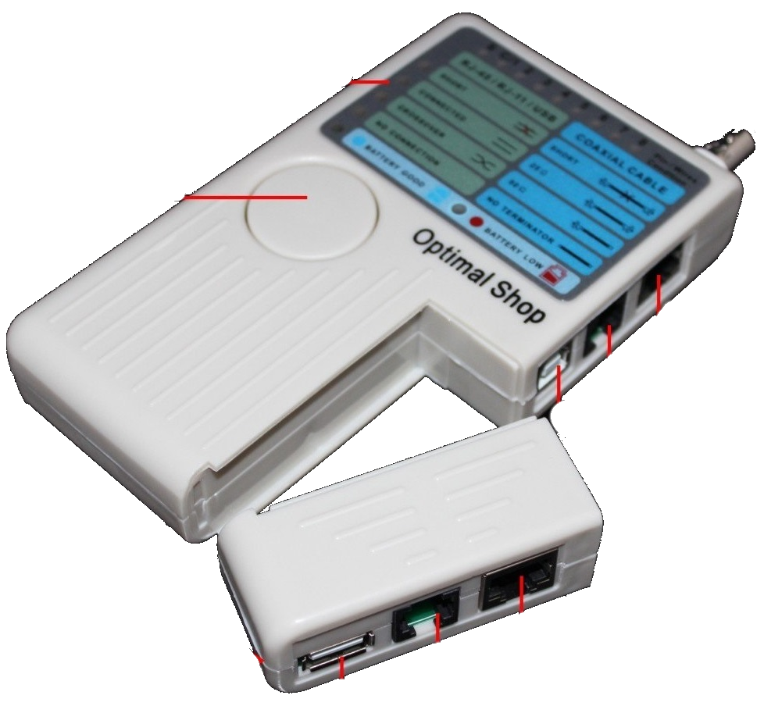
Making a Cable
Main unit
LED display area
BNC (10Base-2, 10Base-5)
Test Button
RJ-45 port
(Networking)
RJ-11 port (Phone)
USB (Type B) port
Remote Module
RJ-45
Cable Tester
RJ-11
USB (Type A)

Slide 16
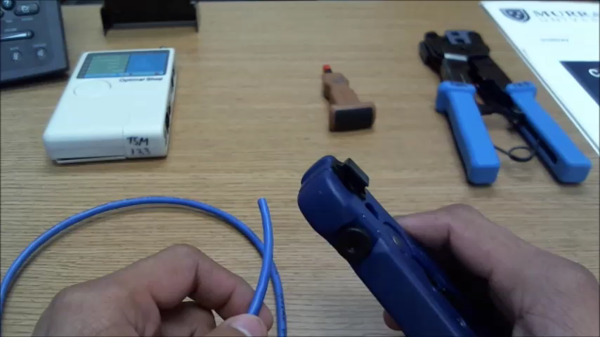
Terminating RJ45
Making an Ethernet cable using T568B wiring standard

